Slide 1

To the Fishbone and Five Whys: Root Cause
ACE Department

Slide 2
Learning Objectives
To understand how to construct a fishbone
To identify and affinitize the potential causes of the problem
To evaluate the link between the fishbone and 5 Whys
To utilize these tools, fishbone, 5 whys, and affinity diagram to discover root cause

Slide 3

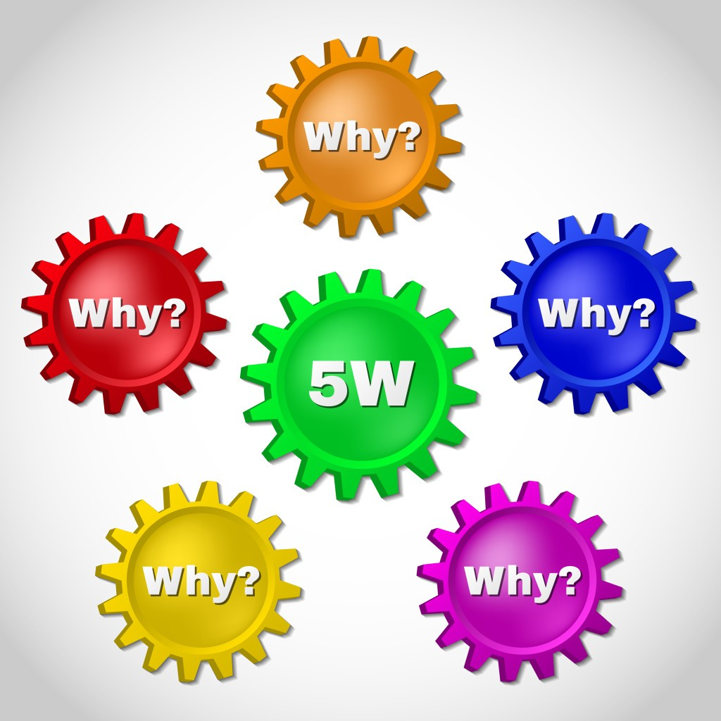

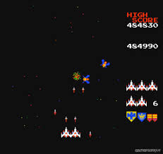
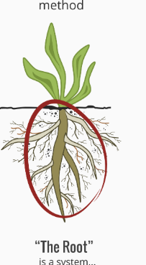


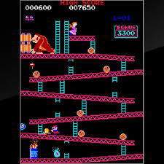
Summary
Cause
5

Slide 4
Traditional Fishbone
AKA
Cause and Effect Diagram
Ishikawa Diagram
Organized brainstorming tool
Often taught by using 6M’s or 6P’s
-Man, Method, Machine, Materials, Measurement, Mother Nature
-People, Policy, Plant, Process, Product, Program

Slide 5
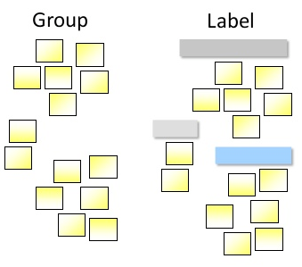
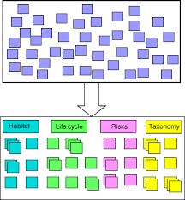
The Brainstorm
Brainstorm
Affinitize the Causes
Go to the Genba
Go and See, look for gaps and causes
Go for Quantity
Encourage the team to come up with as many causes for the effect or problem
Create groups and Label

Slide 6
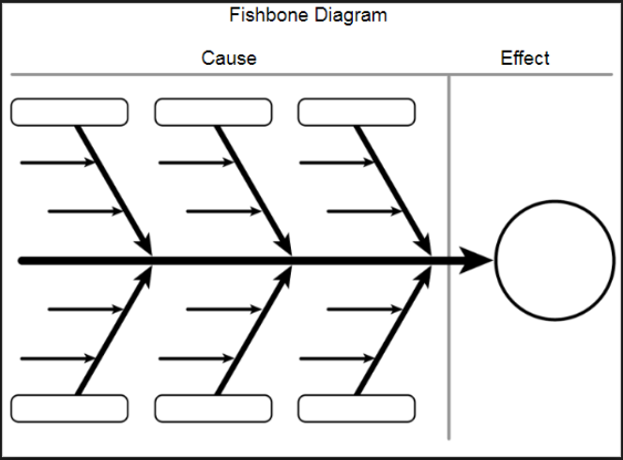
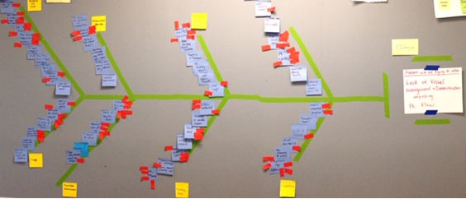
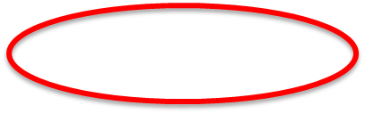
The Fishbone
Build the Fishbone
Multi-Vote
Use labels to organize to the body
Causes go to the left of the bone
Makes the number of causes more manageable
Prioritizes the work
Team agreement

Slide 7
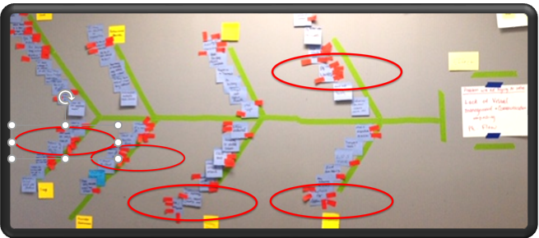
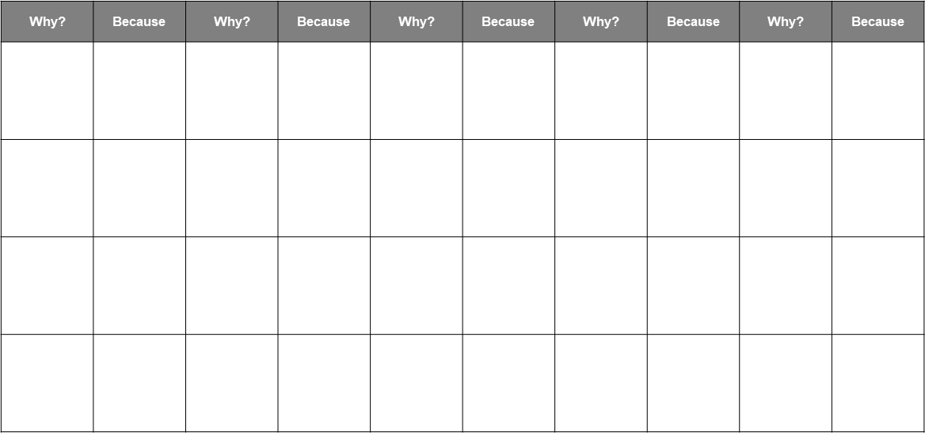
5 Whys
Take causes with the most votes and do a 5 Why to get to root cause

Slide 8
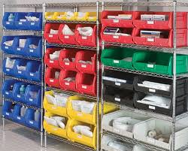
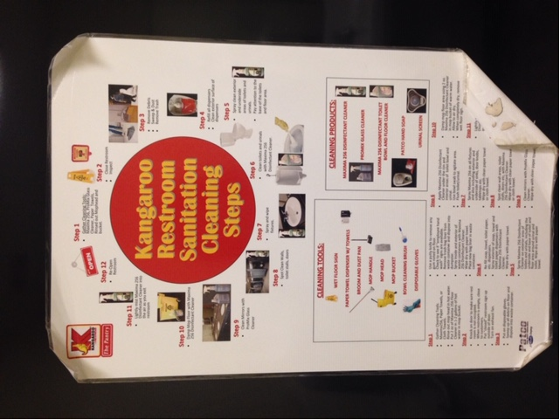
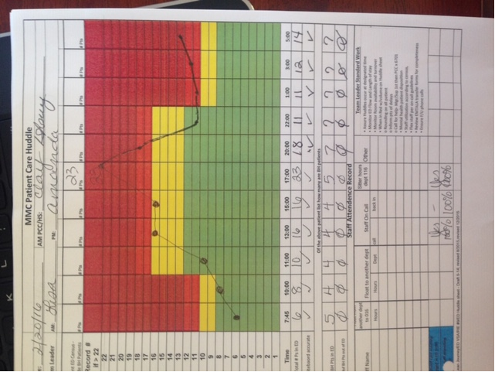
5 Hows
Countermeasures
Have the team come with 5 ways to solve for each root cause
Encourage creativity
Encourage strength of countermeasure
Think visual controls, 5S, standardization, set up reduction, mistake proofing etc…

Slide 9
Exercise
Turnover Rate in XX Department is 35%

Slide 10
Brainstorm

Slide 11
5 Whys
5 Hows

Slide 12

QUESTIONS?

Slide 13

Survey Time! Only 3 Questions.

